Slide 1
Progress on the Industrial Use Cases
Model Writer

Slide 2
UC-FR-01 - Synchronization between models and documents
Yvan lussaud
OBEO

Slide 3
UC-FR-01 Synchronization between models and documents
Sirius
Development of Sirius
Problematic
Concern

Slide 4
UC-FR-01 Sirius
Open source Eclipse project
Creates graphical modelers
Easy to use (Diagram, table, tree, …)
Domain Specific language
View point approach

Slide 5
UC-FR-01 Development of Sirius
Graphical Mapping DSL
Source code
Documentation (specifier, user)
Life cycle
Artifacts
Release train Eclipse
Dependencies
Team
Core team
External contributors
Methodology
Code review
Plan manual synchronization of artifacts

Slide 6
UC-FR-01 Problematic
Synchronization gap
Validation
Development
Release
Artifacts knowledge is volatile
Quality

Slide 7
UC-FR-01 Concern
Internal validation of ModelWriter approach
Contribute to Intent
Mapping tooling
Live validation feedback
Batch validation
Fixing assistance

Slide 8
UC-FR-02 - Enterprise Architecture
Yvan lussaud
OBEO

Slide 9
UC-FR-02 Enterprise Architecture
SmartEA
Enterprise Architecture
Problematic
Concern

Slide 10
UC-FR-02 SmartEA
Centralize information
Ease communication in the company
Support changes in the company
Model the company
Business opportunities, business changes, interoperability, new technologies
Gap analysis
Technical information
View point approach
Impact analysis
Eclipse and Sirius editors
Internal model can be changed (TOGAF9, BPMN, …)
Web portal

Slide 11
UC-FR-02 Enterprise Architecture
Define As-Is state
Import documents
Define To-Be state
Modify the company model
Consolidate the company model
Define trajectories
Gap analysis
Impact analysis
Define milestones
Identify possible scenario
Evaluate possible scenario

Slide 12
UC-FR-02 Problematic
Validation
Organizational changes
Produce documentation of organizational changes
Artifacts knowledge is volatile
Quality
Synchronization gap
Documentation
Keep track of sourced documents
Keep representation and portal up-to-date

Slide 13
UC-FR-02 Concern
Industrial use of ModelWriter tooling
Contribute to Intent
Mapping tooling
Live validation feedback
Batch validation
Fixing assistance

Slide 14
UC-FR-03 - Synchronization of Regulation Documentation with a Design Rule Repository
Anne MONCEAUX
Airbus Group Innovation
Louis ROUCH, Ayhan MOHOVIC
Airbus SAS

Slide 15
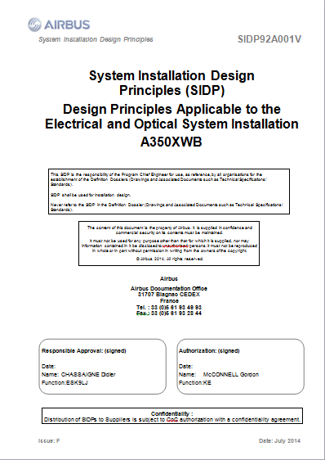
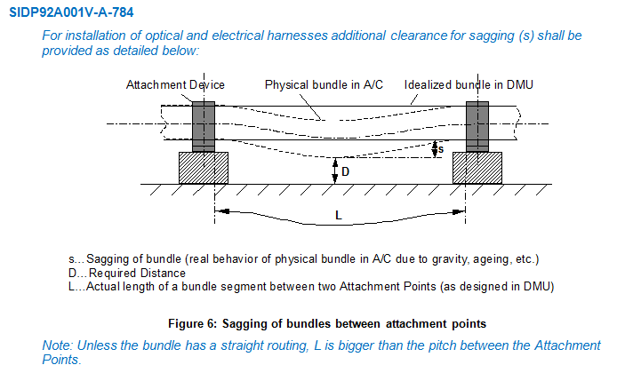
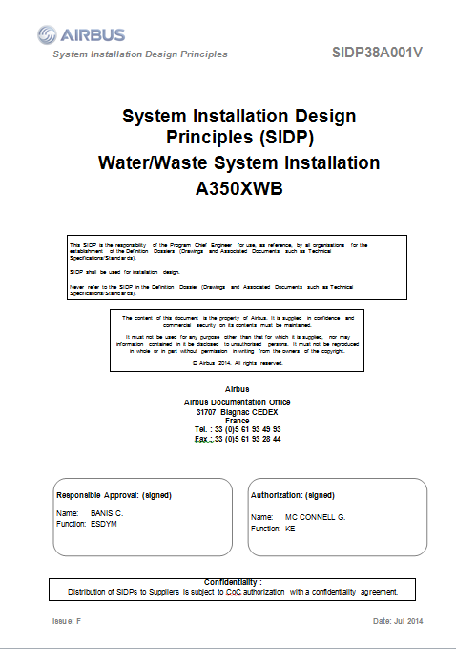
SIDP: “System Installation Design Principles”
Notes:
SIDP is used (under Non Disclosure agreement) as a use case

Slide 16
Context and problem
SIDP documents explain how to install the aircraft systems and attach them to the structure. They capitalize the best practices & proven technical solutions.
SIDP are defined per ATA chapter (~functional domain) to be applied for each given A/C project: for example “A350 Electrical installation”
SIPD are open to Extended Enterprise: installation tasks are performed by risk sharing partners.
SIDP are living documents: during the aircraft development any new DP allowing to satisfy all targets/constraints can be added, assuming it is validated by Airbus dedicated committee.

Slide 17
Industrial high level needs
To improve SIDP creation, maintenance and consultation in order to:
save costs by supporting DP consultation / retrieval in accordance to the needs
avoid non-compliance of design caused by DP updating lead times
keep traceability with upstream regulations and requirements and downstream design models

Slide 18
Synchronization of regulation documentation with a design rule repository

Slide 19

UC-FR-03 Synchronization of regulation documentation with a design rule repository
Goal: synchronizing the SIDP database content with documentation
Create links between text fragments & model elements (manual annotation?, semi-automatic?…)
Manage consistent synchronization (manage changes)

Slide 20
UC-FR-03 Synchronization of regulation documentation with a design rule repository
Approach: limited case on Electrical Installation functional domain
(Confidential Data - Non Disclosure Agreement finalized in June 2015).
Text
1 document: SIDP ATA 92
In our industrial context SIDP are edited using MSWord
Models
An OWL model is built that reflects the DB schema: “Rule ontology” (30 classes, 35 object properties and 54 data properties)
Automatic population mechanism of the model from a csv BD export produces the KB (45781 triples)
Notes:
Why an OWL model?
- Natural

Slide 21
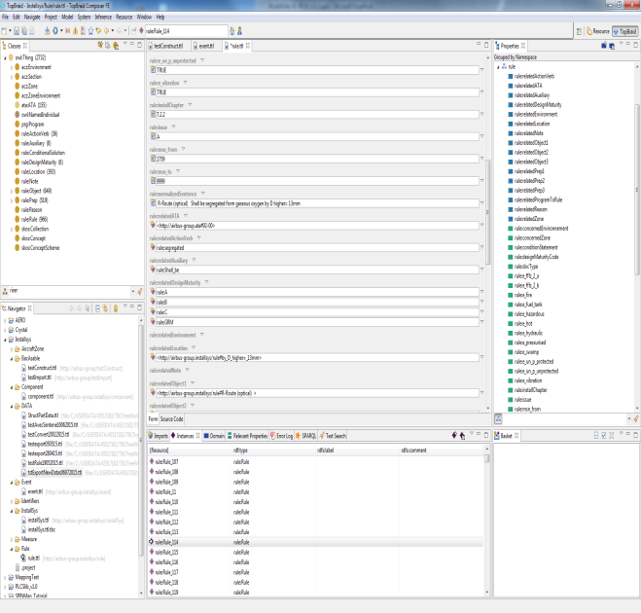
UC-FR-03 Synchronization of regulation documentation with a design rule repository
Status 1st iteration: synchronizing the SIDP KB content and text part
Thermal variation shall be taken into account
Structural deformation shall be taken into account
Pressurization Variation shall be taken into account
Component/Item/Object shall be qualified to withstand temperature reached by the routes they are in contact with
Model part = rule KB
Textual part = rule sentences

Slide 22
UC-FR-04 - Production of a Context Specific Design Document
Anne MONCEAUX
Airbus Group Innovation
Louis ROUCH, Ayhan MOHOVIC
Airbus SAS

Slide 23
UC-FR-04 Production of a context specific design document
Goal: producing document according to usage “needs”
Produce “filtered” document with subset of Design Principle textual elements according to usage “needs”

Slide 24
UC-FR-04 Production of a context specific design document
Approach:
use case Electrical Installation functional domain
Confidential Data - Non Disclosure Agreement finalized in June 2015
Use model elements to retrieve relevant Design Principles
Text
1 document: SIDP ATA 92
In our industrial context SIDP are edited using MSWord
Models
The previous Rule KB (populated Rule ontology)
Component ontology (476 classes, 21 ObjectProperties and 35 DataProperties)
Notes:
Why an OWL model?
- Natural

Slide 25
Component classes taxonomy
ObjectProperties
Component
Assembly
“Structural_Element”
subClassOf
“Bracket”
Physical component
Attachment device
“Fastener”
“Pclamp”
Clamp
AnnotationProperties
Rdfs:label
“Assembly”
Skos:prefLabel
P-Clamp
P-Clamp NSA5516

Slide 26
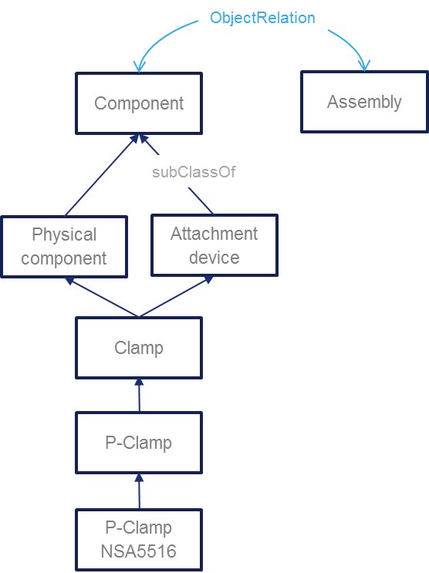
Component classes taxonomy
“P-clamp NSA5516 can be fixed on X with Y”
“Physical component”
“Standard reference”
NLP Parsing uses this taxonomy. Labels + assumptions such as a physical component may be referred to using its name or its reference or both concatenated
Inference rule: a rule applying to a component type (Attachment device) applies to its subtypes (P-clamp)
Document display : when searching rules applying to a component type (P-Camp) → retrieve and display rules applying to super-types

Slide 27
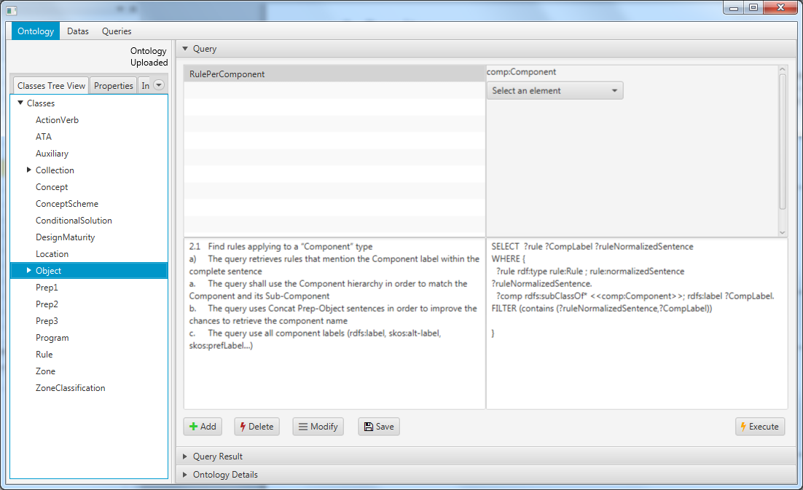
SPARQL queries
Status : model based queries specification
Preliminary study with Loria (Text to RDF)
1 internship on RDFizer and Query management

Slide 28
UC-TR-01 - Production of a Context Specific Design Document
us SAS

Slide 29
Thank you for your attention! Any question ?

